Slide 1
Designing Relational Databases
Smart Table Design (2nd and 3rd Normal Forms)
Notes:
Start by explaining that dbs can be built up by identifying the objects in an environment. Think like a programmer, id actors and relationships

Slide 2
Data Storage
Normally, we can identify objects (Entities) in the environment we wish to develop a database for
So in a school setting…
Course
Student
Instructor
Team
GPA
Classroom
Program
Club

Slide 3
Add in Relationships
We could then say that an Instructor teaches a Student, a Student takes a Course, a Course is conducted in a Classroom etc…
Course
Student
Instructor
Team
GPA
Classroom
Program
Club

Slide 4
Build Tables for each Object
We could then start building tables for each object
Course
Instructor
Student
Team
GPA
Classroom
Program
Club
Notes:
Build tables by identifying attributes (adjectives, properties) of each object

Slide 5
One Big Table
Sometimes it does not happen that way, in fact we may start building a table and just add columns as we go
StudentNo | FName | LName | Course | Instructor | Classroom | Housing | Dorm | Club

Slide 6
One Big Table
Then we add the data we have at the moment
StudentNo | FName | LName | Course | Instructor | Classroom | Housing | Dorm | Club
100 | John | Doe | COMP3002 | Maziar | D112 | No |  | Computer

Slide 7
One Big Table
But then we find out that John is also taking COMP2006 and he also belongs to the Movie club.
StudentNo | FName | LName | Course | Instructor | Classroom | Housing | Dorm | Club | Club2
100 | John | Doe | COMP3002, COMP2006 | Maziar | k112 | No |  | Computers | Movies
Already you see some problems, anyone working with this table has to do a lot of work.
Objects are forced to be in one table and most importantly the table is NOT in first normal form (1NF)

Slide 8
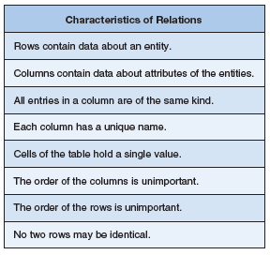
First Normal Form
Looking at the definition for 1NF, we see that already we broke this first rule.
StudentNo | FName | LName | Course | Instructor | Classroom | Housing | Dorm | Club | Club2
100 | John | Doe | COMP3002, COMP2006 | Maziar | K112 | No |  | Computers | Movies
Kroenke & Auer
Notes:
We broke point #5

Slide 9
First Normal Form
Attributes of a Student Entity does include names, but also the Program the student is in, perhaps the courses they take, a GPA and so on.
StudentNo | FName | LName | Course | Instructor | Classroom | Housing | Dorm | Club | Club2
100 | John | Doe | COMP3002, COMP2006 | Maziar | K112 | No |  | Computers | Movies
Kroenke & Auer
Notes:
Not many attributes of the student are shown here, in fact if we entered all, we would have a very long table

Slide 10
First Normal Form
Each column must contain the same type of data, int, characters etc.
Each column must have a unique name and if the PK is used as a FK in another table, the column names should be the same (but not necessary)
StudentNo | FName | LName | Course | Instructor | Classroom | Housing | Dorm | Club | Club2
100 | John | Doe | COMP3002, COMP2006 | Maziar | k112 | No |  | Computers | Movies
Kroenke & Auer
Notes:
In this table StudentNo is the PK, but it may be used in another table, say the Courses table where it becomes a FK. So the name StudentNo should be the same in both tables, for ease of understanding and coding

Slide 11
First Normal Form
The cells of the Course column does not hold a single value.
Order (col or row) is not important.
Each row must be given a unique PK value in order for each row to be different
StudentNo | FName | LName | Course | Instructor | Classroom | Housing | Dorm | Club | Club2
100 | John | Doe | COMP3002, COMP2006 | Maziar | K112 | No |  | Computers | Movies
Kroenke & Auer
Notes:
StudentNo is being used as a PK

Slide 12
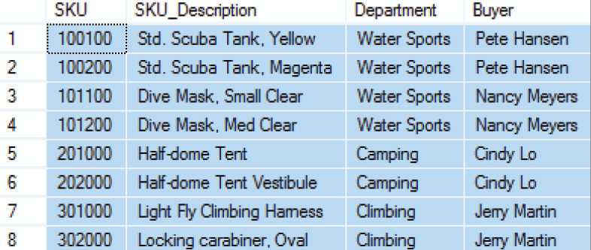
1NF Example
This table is in 1NF because it has a PK, there are no repeating data or rows, all the columns to the right of the PK are related to the PK. Also the values are atomic, meaning we can’t divide them any more
Kroenke & Auer

Slide 13
Getting to 2nd NF
2NF revolves around having a PK and having all the columns in that table depend on that PK
In the Student Activity table does a fee that the student pays for an activity depend on the student herself or on the actual activity?
The answer is, it depends on the cost of the activity which is only half of the PK, and therefore not in 2NF.
This table needs to be brought into 2NF, every column to the right of the composite PK must depend on the entire PK, not just part of it.
Kroenke & Auer
Notes:
Note that in this table, both the StudentID and the Activity columns make up the PK, it is a composite PK

Slide 14
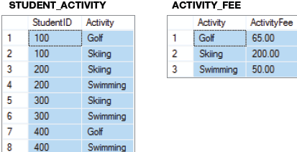
Getting to 2nd NF
A relation is in 2NF if and only if it is in 1NF and all columns (that are not part of the PK) are determined by the entire primary key.
This means that if the primary key is a composite primary key, then no non-key column can be determined by a column or set of columns that make up only part of the key.
In this case the StudentID and Activity act as a composite PK.
Kroenke & Auer
Notes:
It is a composite key because golf appears 2 times, skiing appears 2 times etc, so it must be a composite key

Slide 15
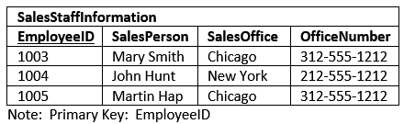
Another Example
This table has two columns which aren’t dependent on the EmployeeID.
The columns are used to describe which office the SalesPerson is based out of, but the columns themselves don’t serve to describe who the employee is.
Another problem, an update anomaly, is that if the sales office moves from Chicago to Champaign, multiple rows will need to be updated.
http://www.essentialsql.com/
Notes:
EmployeeID is the PK, it is underlined. SalesPerson depends on EmployeeID, but SalesOffice does not depend on EmployeeID. You cannot say that employee 1005 works in Chicago for sure, what if they moved. Also OfficeNumber, the telephone number for the office does not depend on the EmployeeID. You can give me an employee id and expect me to tell you the telephone number for her office.

Slide 16
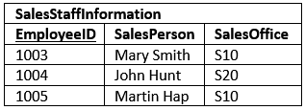

Bringing the SalesStaffInformation to 2NF
A better design will be to create a SalesOffice table with it’s own PK which then becomes a FK in the original SalesStaffInformation table.
http://www.essentialsql.com/
Notes:
So now if we change the Chicago sales office, we change it in just one place and that change will propagate throughout the db

Slide 17
2NF Example
This table is in 2NF because it already in 1NF and all non-key attributes are determined by the PK.
Notes:
It passes 2NF bc there is no composite key

Slide 18
Defining Third Normal Form
A relation is in 3NF if and only if it is in 2NF and there are no non-key attributes determined by another non-key attribute.
In the StudentHousing table we have a single-attribute primary key, StudentID, so the relation is in 2NF because there is no possibility of a non-key attribute being dependent on only part of the primary key.
By identifying the student, we can get the building where he or she is living.
However, the building fee does not depend on the student, it depends on the Building, which is a non-key column.
Notes:
In other words, forget about the PK column and focus on the other columns. If any one of them depend on the other then there is transitive dependency and the table is not in 3NF
Remember that it was in 2NF where the PK was involved in the dependency situation, but in 3NF we are looking at the columns that are not a PK or part of a PK, so everything else
The same fee is charged for every room in a building, so the Randolph costs 3200, the Ingersol is 3400 etc. Therefore, it is the Building that determines the fee being charged, NOT the student.

Slide 19
Getting to 3NF
To put the relation into 3NF, we will have to move the columns of the functional dependency into a separate relation while leaving the determinant (Building) in the original relation as a foreign key.
This means that we will have to build 2 tables.

Slide 20
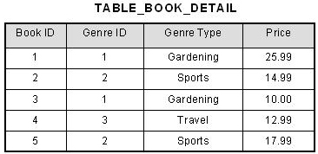
Another Example of 3NF
Try to move this table to 3NF

Slide 21
3NF Example
This table is NOT in 3NF because in this particular company, the Buyer is dependent on the Department. In other words Pete Hansen cannot be a buyer for both Water Sports AND Camping or Climbing.
Notes:
With more information we find out that Buyers are assigned to a particular department

Slide 22
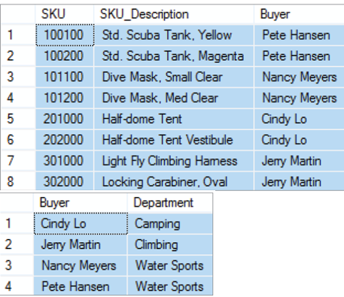
3NF Solution
Create 2 tables one for Sku’s only and one for Buyer -> Department.

Slide 23
The Domain integrity Constraint
The requirement that all of the values in a column are of the same kind is know as the domain integrity constraint.
The term domain means a grouping of data that meets a specific type definition.
FirstName could have a domain of names such as Albert, Bruce, Cathy, David, Edith, and so forth.
All values of FirstName must come from the names in that domain.

Slide 24
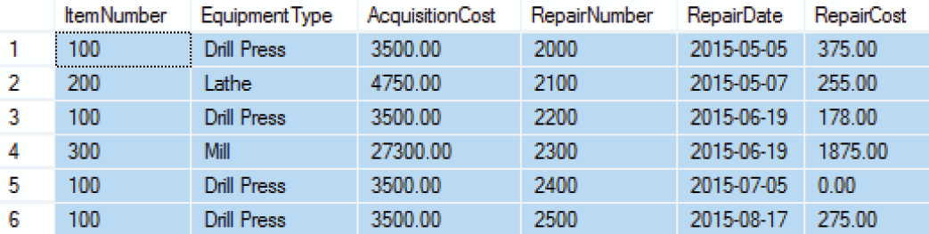
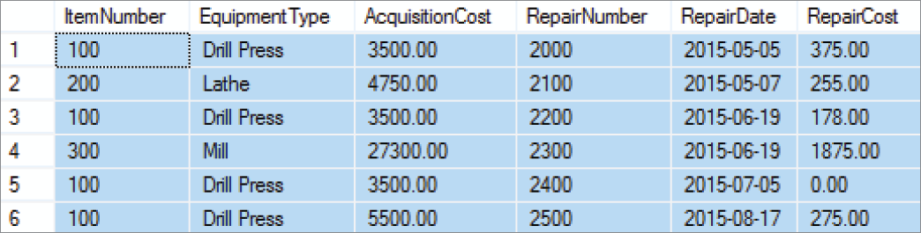
Modification Anomalies
The EQUIPMENT_REPAIR table before and after an incorrect update operation on AcquisitionCost for EquipmentType = Drill Press:

Slide 25
Modification Anomalies
Deletion anomaly
Insertion anomaly
Update anomaly
The EQUIPMENT_REPAIR table duplicates data. For example, the AcquisitionCost of the same item of equipment appears several times.
Any table that duplicates data is susceptible to update anomalies. A table that has such inconsistencies is said to have data integrity problems

Slide 26
https://www.youtube.com/watch?v=y03oYWDLu0Q
https://www.youtube.com/watch?v=jgUeOjImOOw
https://www.youtube.com/watch?v=9L10Q1nAfyg
https://www.youtube.com/watch?v=_K7fcFQowy8

